Slide 1




Sweet Temptations: How To Catch the Hackers
Matt Boddy @infosecBoddy
Notes:
Introduction
What we’ll cover
How we at Sophos have used honeypots to help enhance sales and marketing efforts
How could a honeypot be setup in a clients environment
A practical hands on ‘how to’ setup a honeypot and hack it.

Slide 2
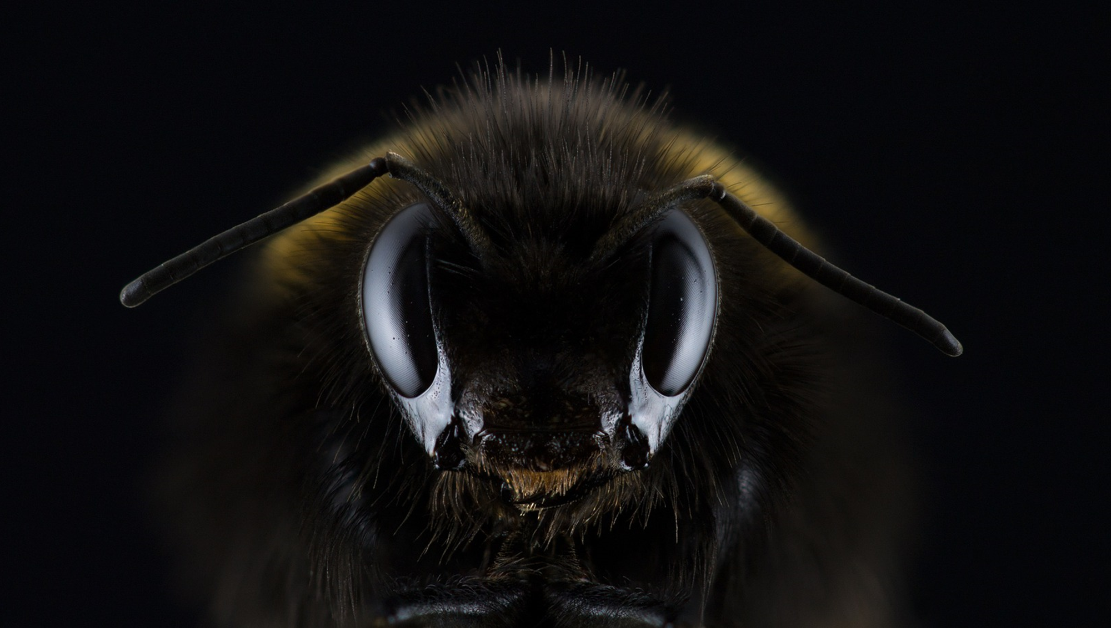

Slide 3
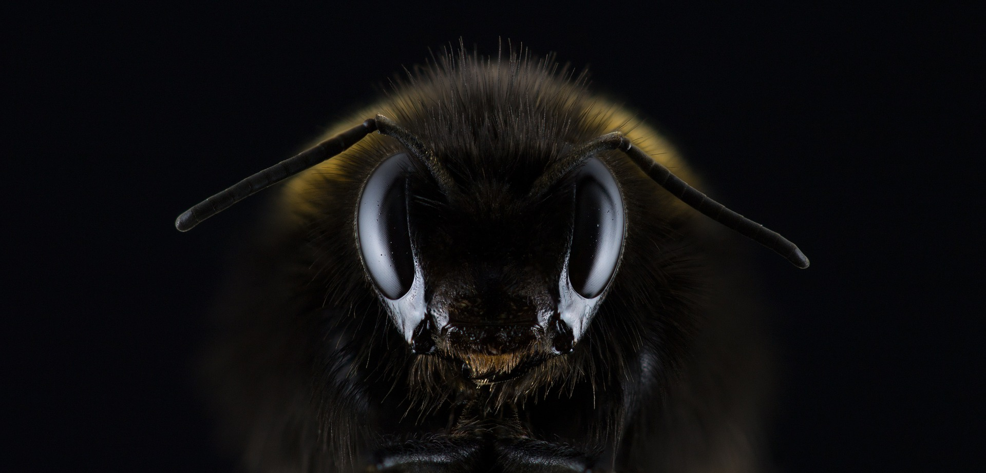
Default usernames
Username | Login attempt count
root | 5,211,644
admin | 47,816
user | 6,345
ubnt | 5,469
ubuntu | 2,585
nagios | 2,520
pi | 2,217
postgres | 1,748
Taken from 10 honeypots over a 30 day period
Notes:
Password defaults
123456 - CCTV cameras
Admin – CCTV cameras & routers & NAS
1234 – CCTV cameras
Password – NAS
12345 – Panasonic CCTV
Ubnt – ubiquity networks
Root – D-max cctv cameras
123 – YooSee CCTV
blank – Microtik routers & Axis/Vivotek IOT
Raspberry – Raspbian

Slide 4
Default usernames
Username | Login attempt count
root | 5,211,644
admin | 47,816
user | 6,345
ubnt | 5,469
ubuntu | 2,585
nagios | 2,520
pi | 2,217
postgres | 1,748
Taken from 10 honeypots over a 30 day period
Notes:
Password defaults
123456 - CCTV cameras
Admin – CCTV cameras & routers & NAS
1234 – CCTV cameras
Password – NAS
12345 – Panasonic CCTV
Ubnt – ubiquity networks
Root – D-max cctv cameras
123 – YooSee CCTV
blank – Microtik routers & Axis/Vivotek IOT
Raspberry – Raspbian

Slide 5
Default usernames
Username | Login attempt count
root | 5,211,644
admin | 47,816
user | 6,345
ubnt | 5,469
ubuntu | 2,585
nagios | 2,520
pi | 2,217
postgres | 1,748
Taken from 10 honeypots over a 30 day period
Notes:
Password defaults
123456 - CCTV cameras
Admin – CCTV cameras & routers & NAS
1234 – CCTV cameras
Password – NAS
12345 – Panasonic CCTV
Ubnt – ubiquity networks
Root – D-max cctv cameras
123 – YooSee CCTV
blank – Microtik routers & Axis/Vivotek IOT
Raspberry – Raspbian

Slide 6
Default usernames
Username | Login attempt count
root | 5,211,644
admin | 47,816
user | 6,345
ubnt | 5,469
ubuntu | 2,585
nagios | 2,520
pi | 2,217
postgres | 1,748
Taken from 10 honeypots over a 30 day period
Notes:
Password defaults
123456 - CCTV cameras
Admin – CCTV cameras & routers & NAS
1234 – CCTV cameras
Password – NAS
12345 – Panasonic CCTV
Ubnt – ubiquity networks
Root – D-max cctv cameras
123 – YooSee CCTV
blank – Microtik routers & Axis/Vivotek IOT
Raspberry – Raspbian

Slide 7
Default usernames
Username | Login attempt count
root | 5,211,644
admin | 47,816
user | 6,345
ubnt | 5,469
ubuntu | 2,585
nagios | 2,520
pi | 2,217
postgres | 1,748
Taken from 10 honeypots over a 30 day period
Notes:
Password defaults
123456 - CCTV cameras
Admin – CCTV cameras & routers & NAS
1234 – CCTV cameras
Password – NAS
12345 – Panasonic CCTV
Ubnt – ubiquity networks
Root – D-max cctv cameras
123 – YooSee CCTV
blank – Microtik routers & Axis/Vivotek IOT
Raspberry – Raspbian

Slide 8
Default usernames
Username | Login attempt count
root | 5,211,644
admin | 47,816
user | 6,345
ubnt | 5,469
ubuntu | 2,585
nagios | 2,520
pi | 2,217
postgres | 1,748
Taken from 10 honeypots over a 30 day period
Notes:
Password defaults
123456 - CCTV cameras
Admin – CCTV cameras & routers & NAS
1234 – CCTV cameras
Password – NAS
12345 – Panasonic CCTV
Ubnt – ubiquity networks
Root – D-max cctv cameras
123 – YooSee CCTV
blank – Microtik routers & Axis/Vivotek IOT
Raspberry – Raspbian

Slide 9
Default usernames
Username | Login attempt count
root | 5,211,644
admin | 47,816
user | 6,345
ubnt | 5,469
ubuntu | 2,585
nagios | 2,520
pi | 2,217
postgres | 1,748
Taken from 10 honeypots over a 30 day period
Notes:
Password defaults
123456 - CCTV cameras
Admin – CCTV cameras & routers & NAS
1234 – CCTV cameras
Password – NAS
12345 – Panasonic CCTV
Ubnt – ubiquity networks
Root – D-max cctv cameras
123 – YooSee CCTV
blank – Microtik routers & Axis/Vivotek IOT
Raspberry – Raspbian

Slide 10
Default usernames
Username | Login attempt count
root | 5,211,644
admin | 47,816
user | 6,345
ubnt | 5,469
ubuntu | 2,585
nagios | 2,520
pi | 2,217
postgres | 1,748
Taken from 10 honeypots over a 30 day period
Notes:
Password defaults
123456 - CCTV cameras
Admin – CCTV cameras & routers & NAS
1234 – CCTV cameras
Password – NAS
12345 – Panasonic CCTV
Ubnt – ubiquity networks
Root – D-max cctv cameras
123 – YooSee CCTV
blank – Microtik routers & Axis/Vivotek IOT
Raspberry – Raspbian

Slide 11
Default passwords
Password | Login attempt count
123456 | 15,735
admin | 12,605
1234 | 9,583
password | 9,034
12345 | 7,145
ubnt | 6,137
root | 5,767
123 | 5,433
 | 3,248
raspberry | 1,808
Taken from 10 honeypots over a 30 day period
Notes:
Password defaults
123456 - CCTV cameras
Admin – CCTV cameras & routers & NAS
1234 – CCTV cameras
Password – NAS
12345 – Panasonic CCTV
Ubnt – ubiquity networks
Root – D-max cctv cameras
123 – YooSee CCTV
blank – Microtik routers & Axis/Vivotek IOT
Raspberry – Raspbian

Slide 12
Default passwords
Password | Login attempt count
123456 | 15,735
admin | 12,605
1234 | 9,583
password | 9,034
12345 | 7,145
ubnt | 6,137
root | 5,767
123 | 5,433
 | 3,248
raspberry | 1,808
Taken from 10 honeypots over a 30 day period
Notes:
Password defaults
123456 - CCTV cameras
Admin – CCTV cameras & routers & NAS
1234 – CCTV cameras
Password – NAS
12345 – Panasonic CCTV
Ubnt – ubiquity networks
Root – D-max cctv cameras
123 – YooSee CCTV
blank – Microtik routers & Axis/Vivotek IOT
Raspberry – Raspbian

Slide 13
Default passwords
Password | Login attempt count
123456 | 15,735
admin | 12,605
1234 | 9,583
password | 9,034
12345 | 7,145
ubnt | 6,137
root | 5,767
123 | 5,433
 | 3,248
raspberry | 1,808
Taken from 10 honeypots over a 30 day period
Notes:
Password defaults
123456 - CCTV cameras
Admin – CCTV cameras & routers & NAS
1234 – CCTV cameras
Password – NAS
12345 – Panasonic CCTV
Ubnt – ubiquity networks
Root – D-max cctv cameras
123 – YooSee CCTV
blank – Microtik routers & Axis/Vivotek IOT
Raspberry – Raspbian

Slide 14
What is a honeypot? – Low interaction

Slide 15


Slide 16
What is a honeypot? – High interaction

Slide 17


Slide 18
How can a honeypot be used in a clients environment?

Slide 19
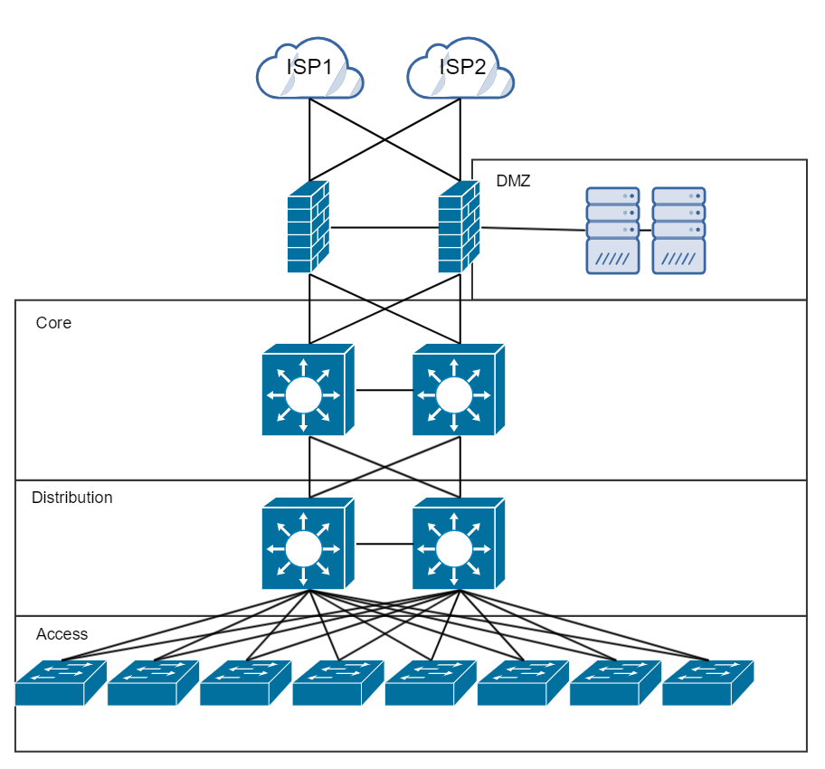
An enterprise network

Slide 20
What we’ll be setting up

Slide 21

Prerequisites
Please make sure that you’ve got all of the following installed.
Python 3
Python 3 IDE (I’m using IDLE)
A means to SSH (Putty, Powershell, Mac command line, Bash etc.)
pip

Slide 22
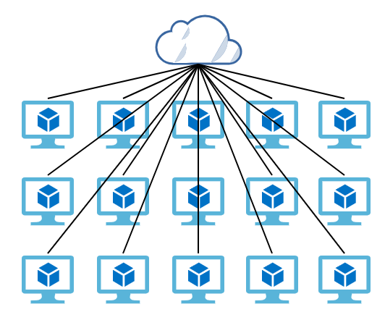
1. SSH Honeypot in Azure
For the duration of this session, you have a virtual Ubuntu server hosted in Azure.
Follow printed instructions to setup your honeypot!
Lock your honeypot down so that it can only be logged into by one relatively basic username and password combo

Slide 23
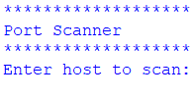
2. Enumerating a honeypot!

Slide 24
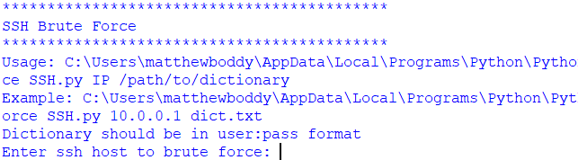
3. Brute force attack a honeypot!

Slide 25
Sweet Temptations: How To Catch the Hackers
Matt Boddy @infosecBoddy
Notes:
Introduction
What we’ll cover
How we at Sophos have used honeypots to help enhance sales and marketing efforts
How could a honeypot be setup in a clients environment
A practical hands on ‘how to’ setup a honeypot and hack it.

